Slide 1
Idle Workers at Mosaic Cafe
By: Jasmine Williams, Isaiah Sarria, Josmar Garcia, Michael Farrelly, and Owen Telis

Slide 2
Introduction
Students enjoy the Mosaic Cafe, but there’s often a very long line that makes the process inconvenient
A study is to be done to see if there’s any improvement to efficiency that can be made
The environment is right here at the IST, at the south side of the building. The space allotted for the cafe is rather small
It’s to be assumed that the workers are idle 80% of the time

Slide 3
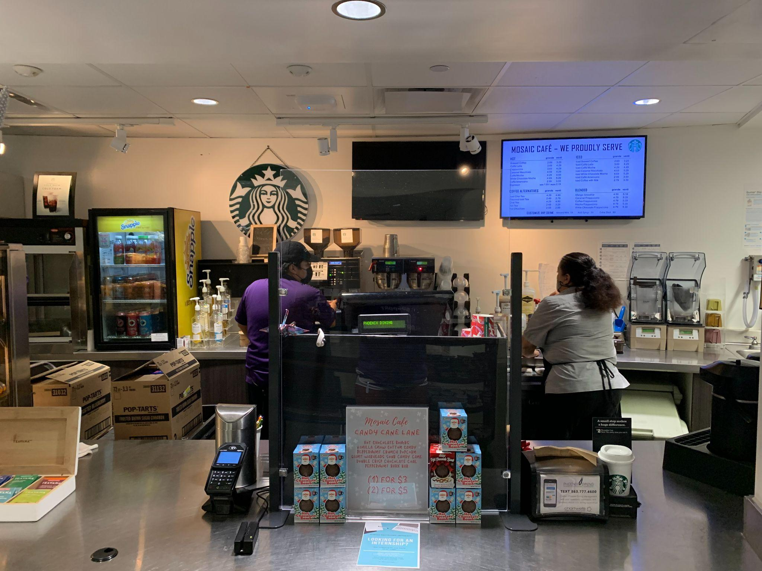
Mosaic Cafe

Slide 4
Purpose and Problem Description
The line at the cafe is usually really long, and can cause many inconveniences to the students
The goal is to investigate what causes the line to be as big as they are, and then to come up with a viable solution to lessen the problem
This problem was chosen because a solution seems feasible, and it can improve the quality of life for the students
We are trying to prove that currently, the efficiency of the Mosaic Cafe is too low, and that there can be improvements to be made.

Slide 5
Methodology (Part 1)
Excel was primarily used to gather data and to perform the calculations necessary
The number of observations is calculated below:
N = ((Z^2)(p)(1-p))/(error^2)
N = ((1.96^2)(0.80)(0.20))/(0.10^2)
N = 62

Slide 6
Methodology (Part 2)
Throughout the day, we had to randomly:
Count the number of students in line
Count the number of workers actually working
Count the number of workers standing idle

Slide 7
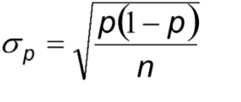
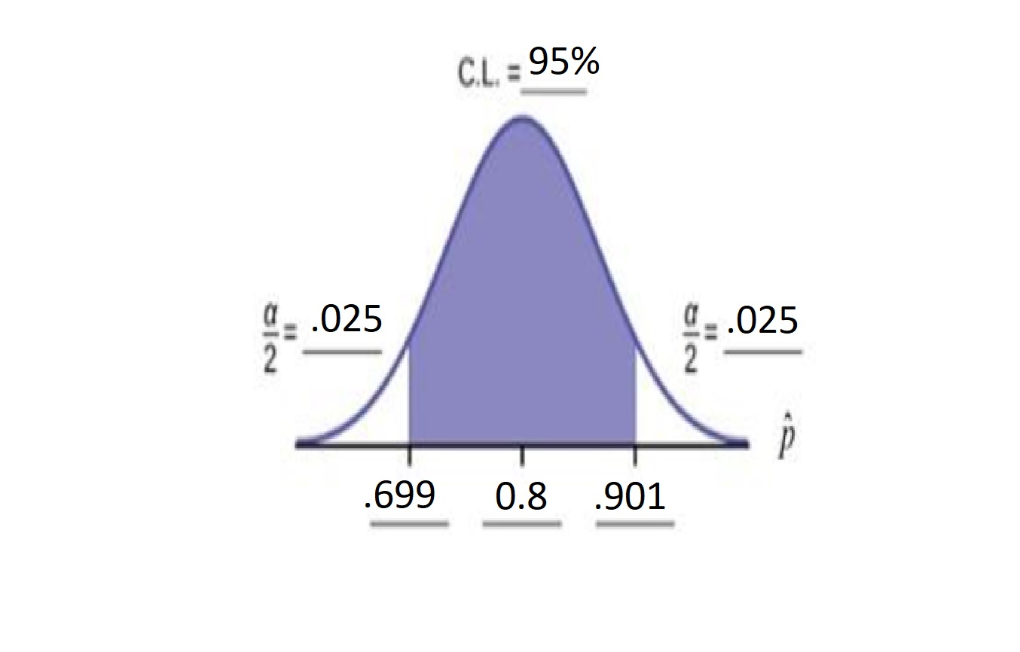
Analysis - Confidence Interval
With above formula, we calculated the estimated sigma level to be .0102 to +/-
Done with an estimate of the idle time being p = .8.

Slide 8
Observed, Normal and Standard Time
Average Observed Time Spent Working w/ customer
2.3 minutes
Normal Time Spent Working w/ customer
2.2 minutes
Standard Time Spent Working w/ customer
2.1 minutes
The observed time was found by translating number of observed occurrences of workers being busy and converting these proportions to reflect their portion of an 8-hour shift each day. Assuming an allowance factor of 9% and a performance rating of 90%, the normal and standard time were computed.

Slide 9
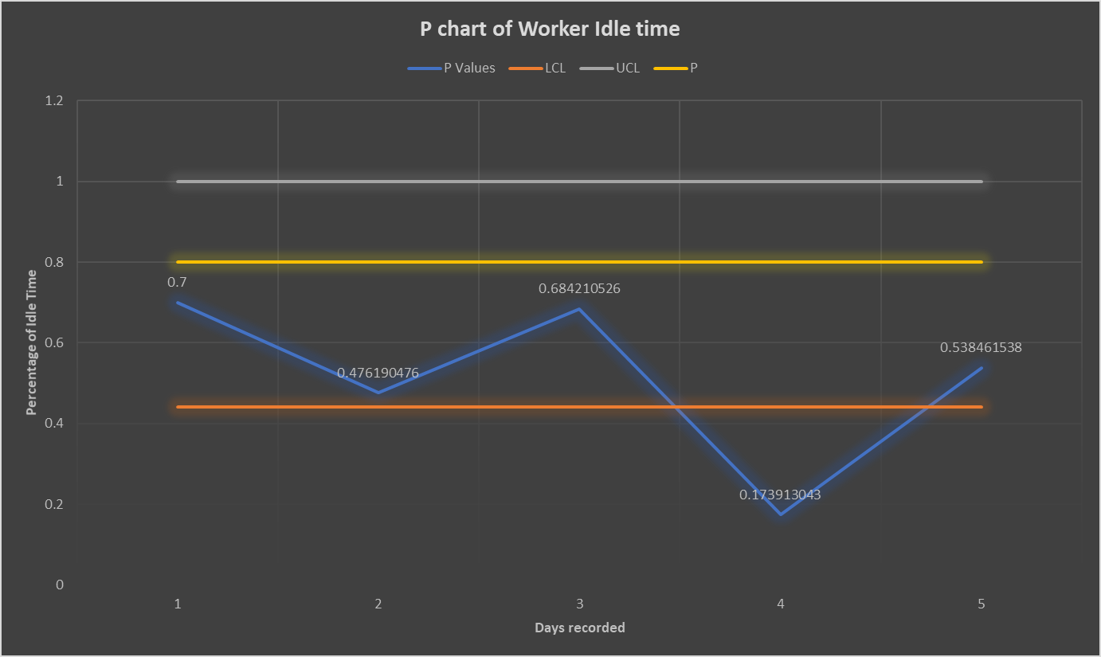
P - Chart
Notes:
Day 4 shows that the cafe should always have 2-3 workers, This allows the cafe to process the line efficiently and not get backed up if a lot of students arrive at the same time.

Slide 10
Data Analysis
The original 80% idle time probability used was incorrect, and a smaller value needed to be shown
The clear indicator of this would be the findings on day 4, which yielded a much larger percentage of working time

Slide 11
Recommendations
Because workers were busier than expected on Tuesday, Friday, and especially Thursday, we suggest hiring more workers on those specific days or
add a second register to process more transactions and orders simultaneously in general

Slide 12
Challenges
One of the challenge is that the workers could be unaccounted for, in the back room, restroom etc.
The P chart gave us trouble since it appeared over the days that our original probability was too high.
One challenge that could have been improved was if we had taken more data points. This would allow our data to be more accurate.

Slide 13
Future Activities
Repeat the study again with a new number of observations and p-value
Include the number of students and how efficient the cafe is processing the queue
Have a variable of time and document how long it takes for the line to be fully processed

Slide 14
Questions?

